Slide 1


MINI PROJECT
QUANTUM-ASSISTED MULTIMODAL FUSION FOR EPILEPSY CLASSIFICATION
Presented to : Prof Mahua Bhattacharya
Dr. Anjali

Slide 2




OUR TEAM
Adarsh Gupta
Ayush Dwivedi
Diwakar Dubey
Ish Sharma

Slide 3
OVERVIEW
Abstract
Methodology
Introduction
Result
Problem
Conclusion
Objectives
Reference

Slide 4
ABSTRACT
Epilepsy diagnosis demands precision, particularly in drug-resistant cases. This project presents a quantum-assisted multimodal fusion framework integrating MRI and PET imaging techniques. MRI provides high-resolution anatomical detail, while PET reveals metabolic activity. By fusing these modalities, we enhance diagnostic clarity and assist clinicians in localizing seizure onset zones. Preprocessing ensures consistency across datasets for accurate fusion. Although EEG is not integrated in this phase, the system is designed for future scalability. The ultimate goal is to enable quantum machine learning (QML) capabilities for next-generation neurodiagnostics.

Slide 5
INTRODUCTION
Epilepsy affects over 50 million people worldwide. In drug-resistant cases, neuroimaging aids in identifying the seizure onset zone for potential surgical intervention. Conventional methods like MRI, PET, and EEG offer unique insights—structural, metabolic, and electrical, respectively. However, single-modality limitations make fusion essential. This project aims to build a reliable, quantum-ready MRI-PET fusion pipeline, with future EEG integration, to improve diagnostic accuracy.

Slide 6
PROBLEM
Identifying seizure zones using standalone imaging techniques can be inconclusive. MRI may miss functional abnormalities, while PET lacks anatomical context. EEG data is noisy and complex. Incomplete diagnostic images hinder treatment planning and machine learning model accuracy. A fusion-based approach can overcome these limitations by creating enriched, aligned diagnostic visuals.

Slide 7
OBJECTIVE
To develop a robust MRI-PET image fusion framework.
To preprocess and harmonize multimodal datasets.
To lay the foundation for EEG integration and QML-based analysis.
To improve precision in seizure localization.

Slide 8
METHODOLOGY: OVERVIEW
Dataset Collection: MRI and PET scans from verified sources.
Preprocessing: Standardized pipelines for harmonization.
Registration: Aligning PET data with MRI anatomy.
Fusion: Combining structural and metabolic information.
Output: Composite image for clinical use and ML training.

Slide 9
METHODOLOGY:
MRI PREPROCESSING
MRI scans are harmonized across multiple sources. This includes normalization of contrast, resolution, and spatial orientation. Consistency ensures compatibility across datasets and accurate fusion with PET.

Slide 10
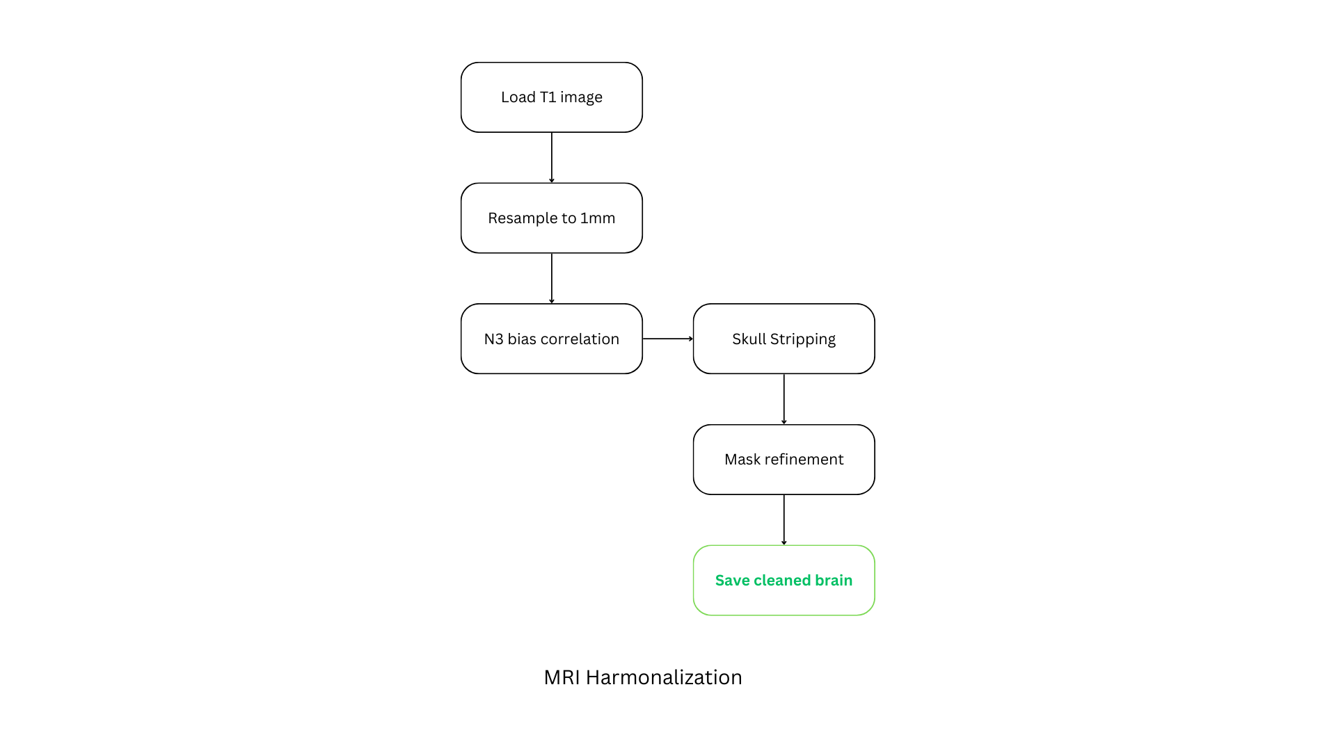
- T1 weighted highlights specefic tissues
- Spatail normalization is crucial
- Corrects scanner-induced intensity inhomogeneities to ensure uniform tissue contrast across scans. is crucial
- Extracts the brain by removing non- brain tissues.
- Ensure clean, precise segmentation.

Slide 11
METHODOLOGY:
PET PREPROCESSING
PET scans are standardized across multiple sources.
This includes correction of orientation, coregistration with MRI, and normalization to a common template space (e.g., MNI space).
These steps ensure accurate anatomical alignment, enhance comparability across datasets, and enable precise fusion with MRI and EEG modalities.

Slide 12
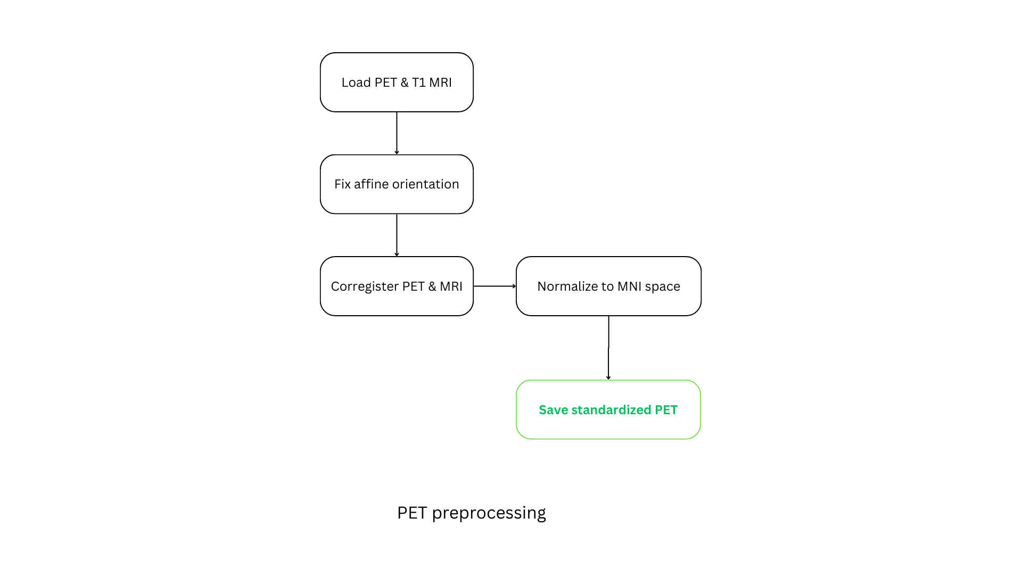
- To spatially align them
- Ensures that both PET and MRI have matching coordinate systems
- Using RBT, PET gets mapped onto MRI space, which improves fusion
- Transforms both images into standard anatomical space

Slide 13
METHODOLOGY:
FUSION STRATEGY
MRI: Base layer for structural precision
PET: Functional overlay via voxel mapping
Fusion preserves anatomical clarity and adds metabolic insights

Slide 14
TOOLS AND LIBRARIES USED
EEG Processing: MNE, pyEDFlib, mne-connectivity
Imaging: Nibabel, nilearn, ANTsPyX
ML & QML: scikit-learn, PyTorch, TensorFlow, PennyLane
IDE & Platforms: VS Code, MATLAB, JupyterLab

Slide 15
QUANTUM MACHINE LEARNING (QML)
WHY QML??!
PennyLane enables quantum-classical hybrid modeling. QML can handle high-dimensional fused datasets more efficiently, allowing for novel biomedical classification and prediction tasks. This future-ready design aligns with emerging trends in quantum healthcare AI.

Slide 16
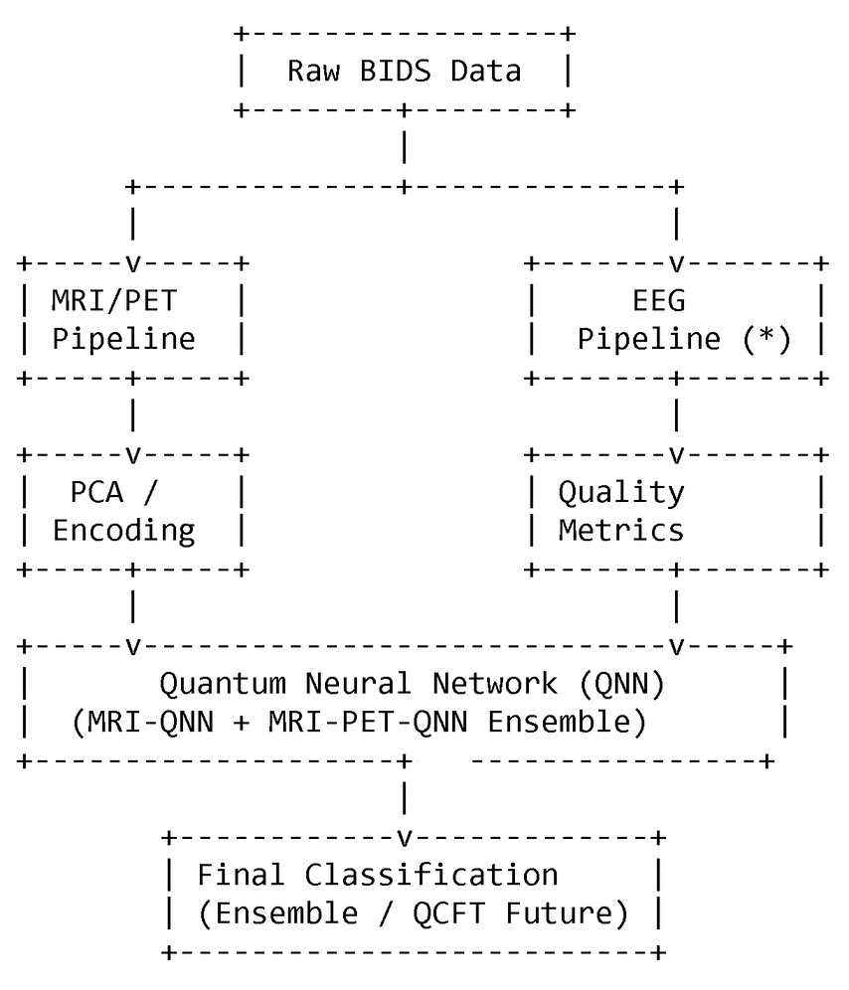
SYSTEM ARCHITECTURE

Slide 17
SYSTEM ARCHITECTURE
DATA INGESTION LAYER
ImpORTS MULTIMODAL BIDS-COMPLIANT DATA:
MRI: IDEAS, AEROBIC GLYCOLYSIS IMAGING
PET: PAIRED WITH MRI (FOR STRUCTURAL-METABOLIC SYNERGY)
EEG (UPCOMING): SEIZEIT2, SRM DATASETS
ORGANIZED IN UNIFIED DIRECTORY FOR STREAMLINED PREPROCESSING AND FUSION

Slide 18
SYSTEM ARCHITECTURE
2. PREPROCESSING & FEATURE EXTRACTION MRI / PET:
MRI / PET:
SKULL STRIPPING (ANTSPY, ANTSPYNET)
INTENSITY NORMALIZATION, RESAMPLING
PCA FOR DIMENSIONALITY REDUCTION (E.G., 10 COMPONENTS)
EEG (PLANNED):
ICA-BASED ARTIFACT REJECTION
QUALITY METRICS: VARIANCE, ENTROPY, BANDPOWER
EPOCHING & DOWNSAMPLING FOR FUSION COMPATIBILITY

Slide 19
SYSTEM ARCHITECTURE
3. QUANTUM NEURAL NETWORK LAYER
QNN-MRI: TRAINED ON MRI-ONLY DATA
QNN-MRI-PET: TRAINED ON COMBINED MRI-PET
ENSEMBLE FUSION:
COMBINES OUTPUTS FOR ROBUST CLASSIFICATION
FUTURE INTEGRATION: EEG → QCFT (QUANTUM-CLASSICAL FUSION TRANSFORMER)
QUANTUM LAYERS SIMULATED (E.G., PENNYLANE PLACEHOLDERS)

Slide 20
SYSTEM ARCHITECTURE
4. DECISION & INTERPRETATION
Final classification: Epileptic / Control
Planned explainability: SHAP, integrated gradients, quantum-aware insights
Outputs: predictions, class probabilities, intermediate features

Slide 21
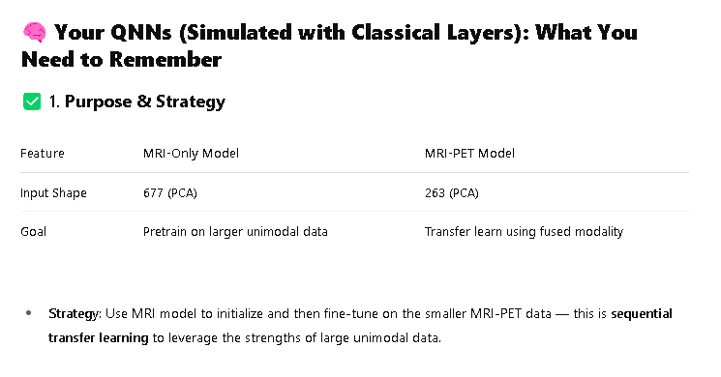
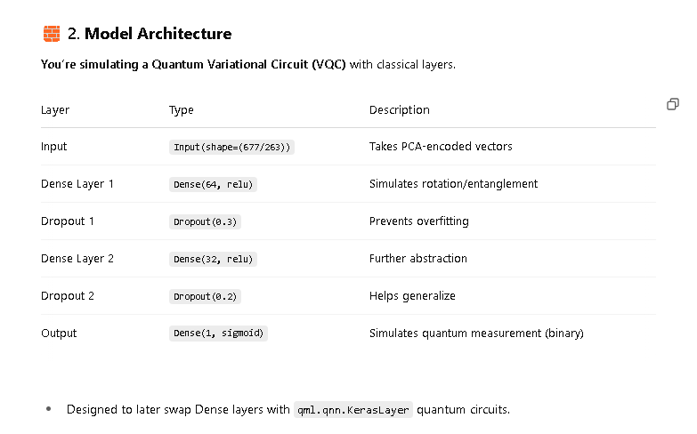
SYSTEM ARCHITECTURE
TECHNICAL JAGRON

Slide 22
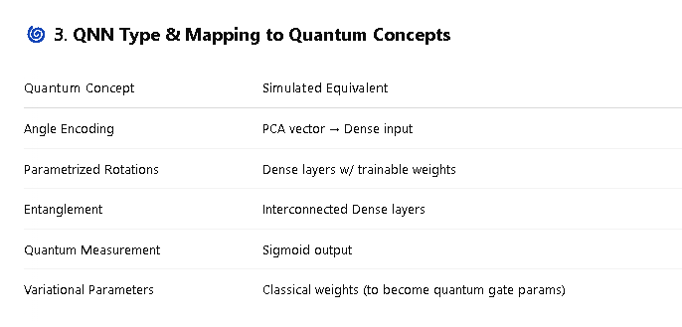
SYSTEM ARCHITECTURE
TECHNICAL JAGRON

Slide 23
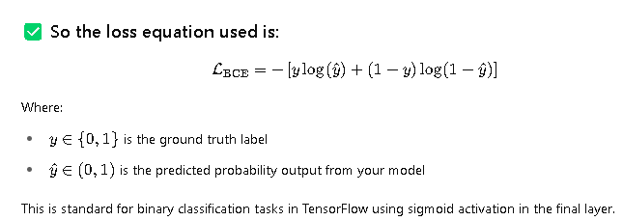
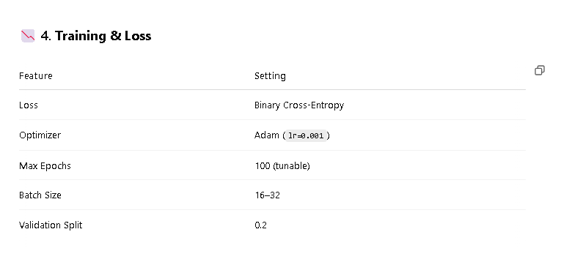
SYSTEM ARCHITECTURE
TECHNICAL JAGRON

Slide 24
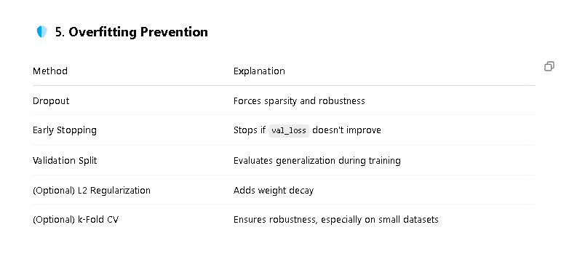
SYSTEM ARCHITECTURE
TECHNICAL JAGRON

Slide 25
RESULTS
CURRENT MILESTONES
→ Trained OVER 64 EPOCHS WITH 81.82% VALIDATION ACCURACY
→ TRAINED OVER 200 EPOCHS WITH 66.67% VALIDATION ACCURACY
→ LEVERAGED MODALITY STRENGTHS FOR BALANCED PERFORMANCE
MRI - ONLY QNN
MRI - PET QNN
ENSEMBLE STRATEGY

Slide 26
RESULTS
TARGETED RESULTS (NEXT PHASE)
Integrate EEG mODALITY FOR RICHER TEMPORAL RESOLUTION
DEVELOP QUANTUM-CLASSICAL FUSION TRANSFORMER (QCFT) FOR IMPROVED FUSION AND HANDLING OF MISSING MODALITIES
TRANSITION TO TRUE QUANTUM VARIATIONAL CIRCUITS (QVC) FOR MODEL EXECUTION
BENCHMARK ACROSS PUBLIC DATASETS (IDEAS, SEIZEIT2, SRM, AGI-PET) TO ENSURE GENERALIZABILITY

Slide 27
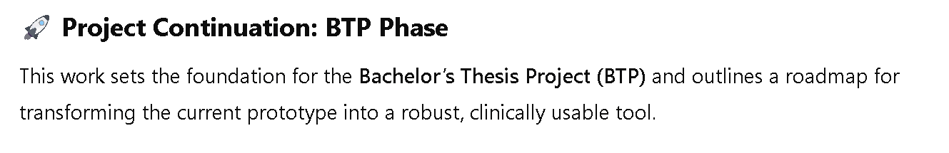
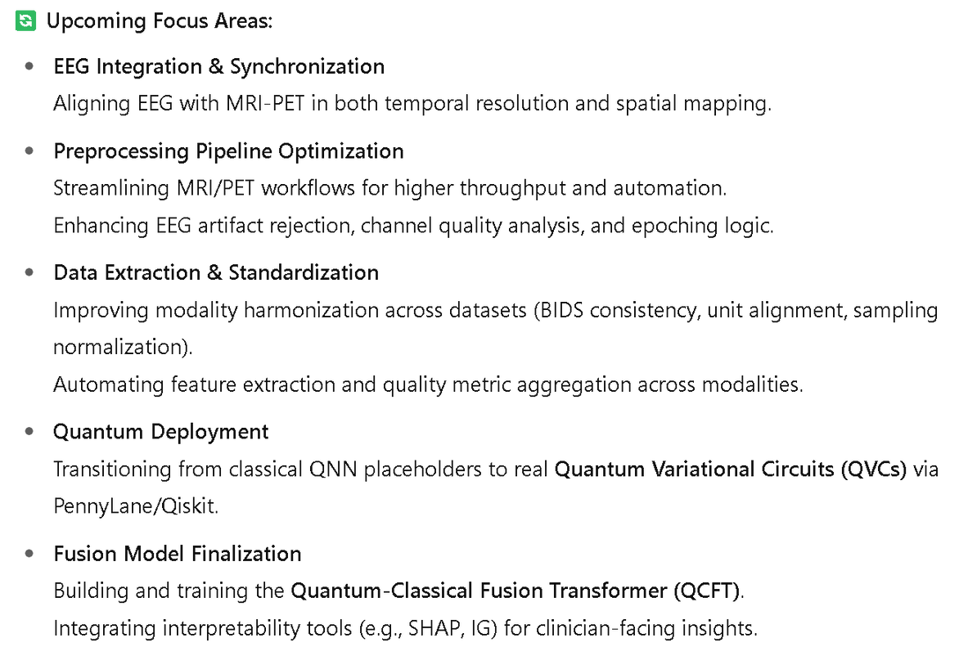
FUTURE PLANS

Slide 28
CONCLUSION
This project demonstrates the potential of multimodal neuroimaging fusion to enhance epilepsy diagnostics. The MRI-PET pipeline supports clearer localization of seizure zones. Future integration of EEG and QML will elevate the clinical and computational power of the system, making it suitable for advanced medical decision-making.

Slide 29
FUTURE SCOPE
Integrate EEG for electrophysiological analysis
Standardize across all three modalities
Implement QML classification pipelines
Expand to other neurological disorders

Slide 30
REFERENCE
Haribabu, M., et al. (2023). Recent Advancements in Multimodal Medical Image Fusion Techniques. Current Medical Imaging.
Liu, C., et al. (2023). Multimodal Fusion using VGG19 in NSCT Domain. Recent Patents on Medical Imaging.
Moghtaderi, S., et al. (2024). Adaptive Image Decomposition for Fusion. Royal Society Open Science.
Wang, Z., Zheng, Y., Zhang, L., Tang, Y., & Bol, S. (2024). A Dual-Branch Network with Attention Mechanism for Multimodal Image Fusion.

Slide 31
THANK YOU!

